Slide 1


Validation of Bangla Rotter’s Internal-External Scale
Mushfiqul Anwar Siraji
mushfiqul.anwarsiraji@monash.edu
@anwar_siraji

Slide 2




Points of discussion
Locus of control
Rotter’s scale
Test development &
validation process
Hands-on
experience

Slide 3
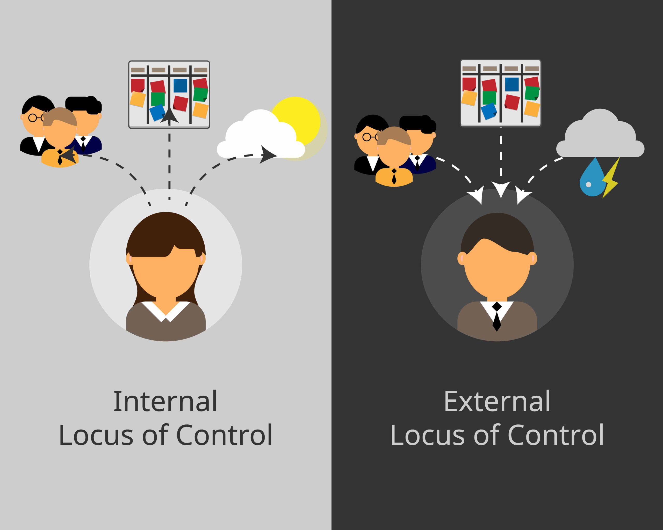
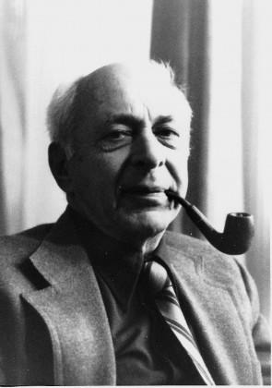
Locus of control
LoC | Rotter’s I-E | Validation | Hands-on
Julian B. Rotter
3

Slide 4
Locus of control
LoC | Rotter’s I-E | Validation | Hands-on
Internals
Externals
Hold other responsible
Assume their own responsibility
Attribute the outcome on luck, fate and other externals
Attribute the outcome to one’s internal qualities and behavior
Has a blaming/victim mentality
I control the consequences of
my behaviour
Consequences of my
behaviour are outside my control

Slide 5
What is Mr. Jim’s locus of control?
LoC | Rotter’s I-E | Validation | Hands-on
Scenario 1
Mr. Jim has received a promotion. He attributed that success to Luck. Because he thinks a better deserving colleague has left the work last month and due to this colleague's absence he received the promotion.
What is Mr. Jim’s Locus of control?
WHAT IF…?
Scenario 2
Mr. Jim has been denied a promotion at work. He blames himself for this failure, such as for not working hard enough. What is Mr. Jim’s Locus of control?

Slide 6
Locus of control: work and health
LoC | Rotter’s I-E | Validation | Hands-on
Internals
Externals
Don’t want to work on self-improvement
Better academic achievement
Good at managing relationships
Good at self-care
Exhibit better openness
Lower effort given to take care of their health
Greater sense of satisfaction
Better self-assessment
Increased depression, anxiety, stress and high neuroticism
Things are in my hands…
Things just got out of the hands…

Slide 7





Let’s play
LoC | Rotter’s I-E | Validation | Hands-on

Slide 8

Rotter’s Internal-External scale
LoC | Rotter’s I-E | Validation | Hands-on
First published in 1966 (Rotter, 1966)
Developed and validated for western individualistic cultures
Rotter conceptualized locus of control and unidimensional
The original Scale had dichotomous response options with 23 item pairs
It has been so far adapted in validated in at least 43 countries (Smith et al., 1995)

Slide 9
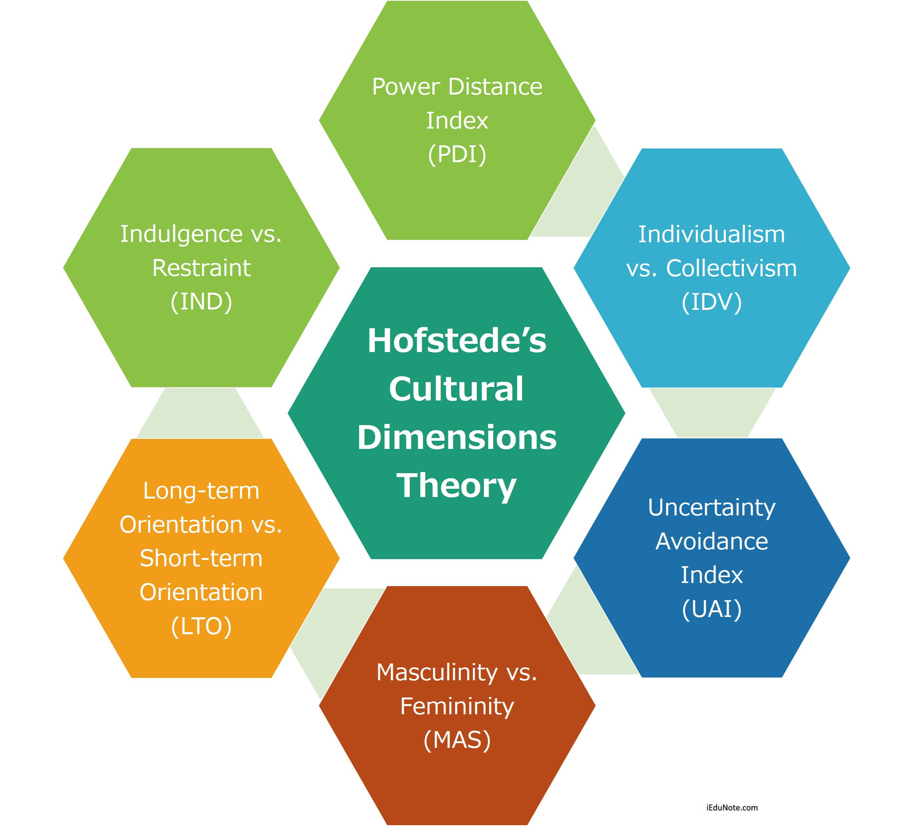
Why validation?
LoC | Rotter’s I-E | Validation | Hands-on
Cultural Influence
Individualism | Collectivism
Micro-family: Everyone is supposed to take care of him or herself | Extended Family: Every one cares for everyone
Speaking one’s mind is health | Harmony should always be maintained
Personal opinion is expected | You are expected to follow the rules of society and family: modesty bias
Task oriented: mastery over the environment’ | Relationship oriented: harmony with the environment’
Locus of Control
(Hofstede, 1980)

Slide 10
Why validation?
LoC | Rotter’s I-E | Validation | Hands-on
Unidimensional or multidimensional
LoC
Political Control
Personal control vs Luck
Social Control
Interpersonal Control
Personal Mobility
Occupational Situation
Locus of Control
(Marsh & Richards, 1987; Smith et al., 1995)

Slide 11




Validation
LoC | Rotter’s I-E | Validation | Hands-on
Locus of Control

Slide 12
Steps of validation process
LoC | Rotter’s I-E | Validation | Hands-on
Chose a protocol to follow
Translate the original scale to the desired language following protocols
Conduct the initial item review (and revisions)
Conduct a large-scale field test of the items.
Item Analysis: classical test theory and item response theory
Estimate reliability
Conduct validation studies

Slide 13

Validation process
LoC | Rotter’s I-E | Validation | Hands-on
Forward Translation
Backward Translation
Translator 3
Bangla
Translator 1
English
English
Synthesized Bangla
Synthesized English
English
Translator 2
Bangla
English
If,
Translator 4
=
Synthesized English
Synthesized Bangla
Stop.
(Bartram et al., 2018)
Otherwise do necessary amendments.

Slide 14

Group activity 1: let’s translate
LoC | Rotter’s I-E | Validation | Hands-on
Time: 8 mins

Slide 15

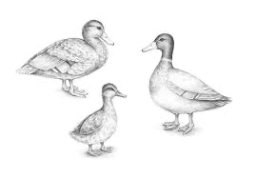

Validation process
LoC | Rotter’s I-E | Validation | Hands-on
Content and Face validity
Face validity
Content validity
Item-level content validity (I-CVI) | Cut-off: 83
scale-level content validity index (S-CVI) | Cut-off: .90
(Polit et al., 2007)

Slide 16
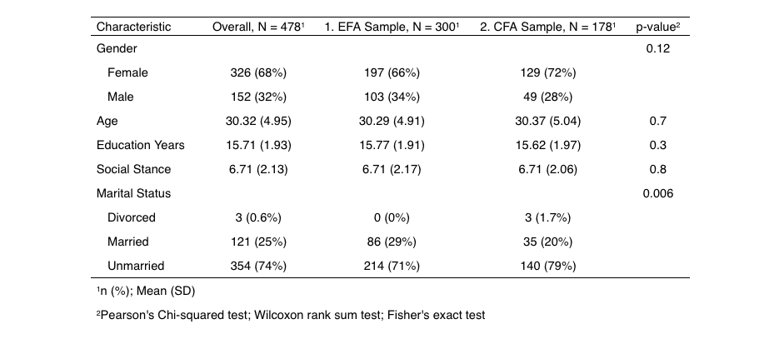
Large scale survey
LoC | Rotter’s I-E | Validation | Hands-on

Slide 17
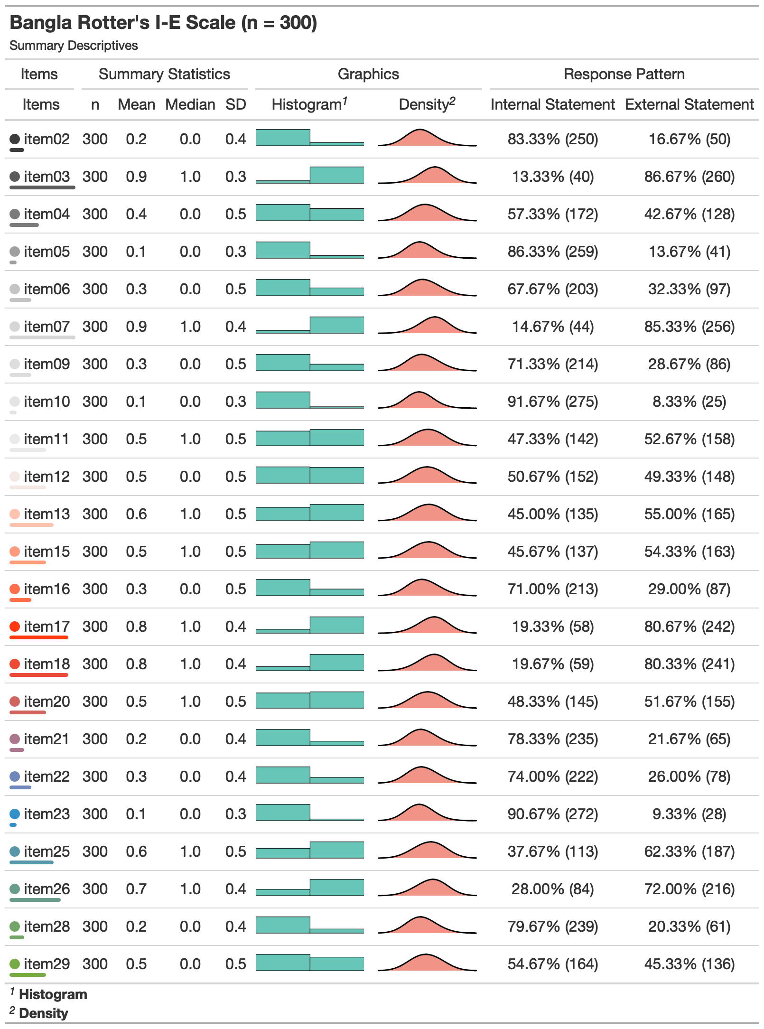
Exploratory analysis
LoC | Rotter’s I-E | Validation | Hands-on
Properties of interest
Univariate Normality | Violated
Multivariate Normality | Violated
Correlation Matrix | Tetrachoric correlations
Item-total correlation | Rule of Thumb: Should be above 0.3/0.4

Slide 18
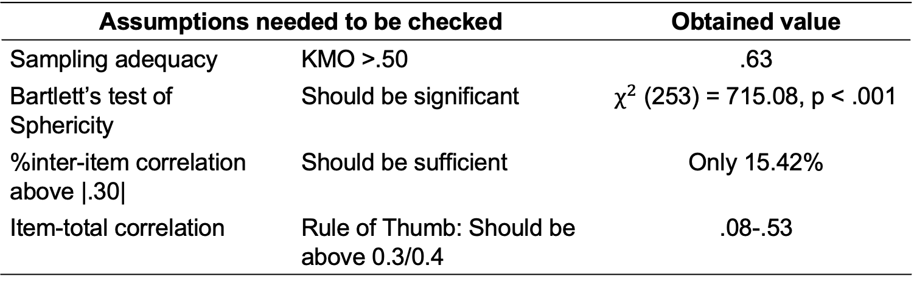
Exploratory factor analysis
LoC | Rotter’s I-E | Validation | Hands-on
Assumptions needed to be checked |  | Obtained value
Sampling adequacy | KMO >.50 | .63
Bartlett’s test of Sphericity | Should be significant | $χ^{2}$ (253) = 715.08, p < .001
%inter-item correlation above |.30| | Should be sufficient | Only 15.42%
Item-total correlation | Rule of Thumb: Should be above 0.3/0.4 | .08-.53
(Child, 2006; Comrey & Lee, 1992; Fabrigar et al., 1999; Mulaik, 2009; Watkins, 2020)

Slide 19
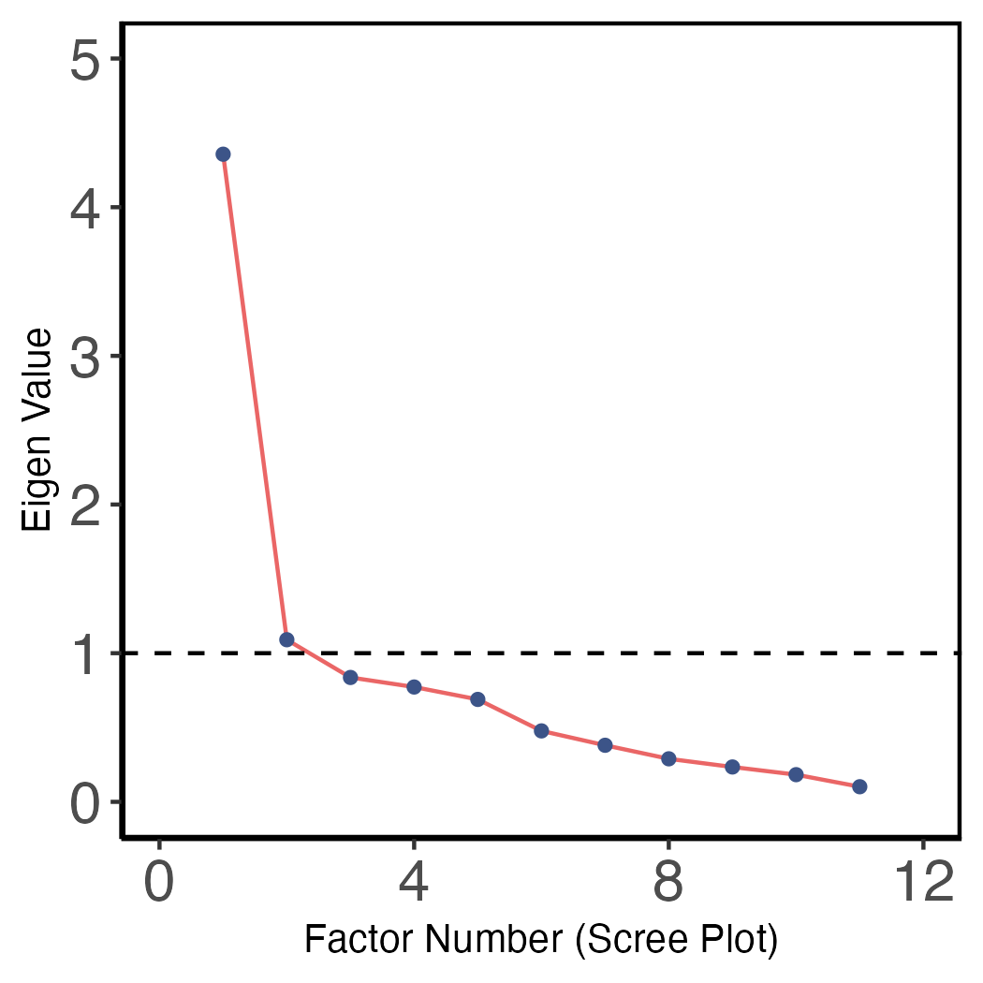
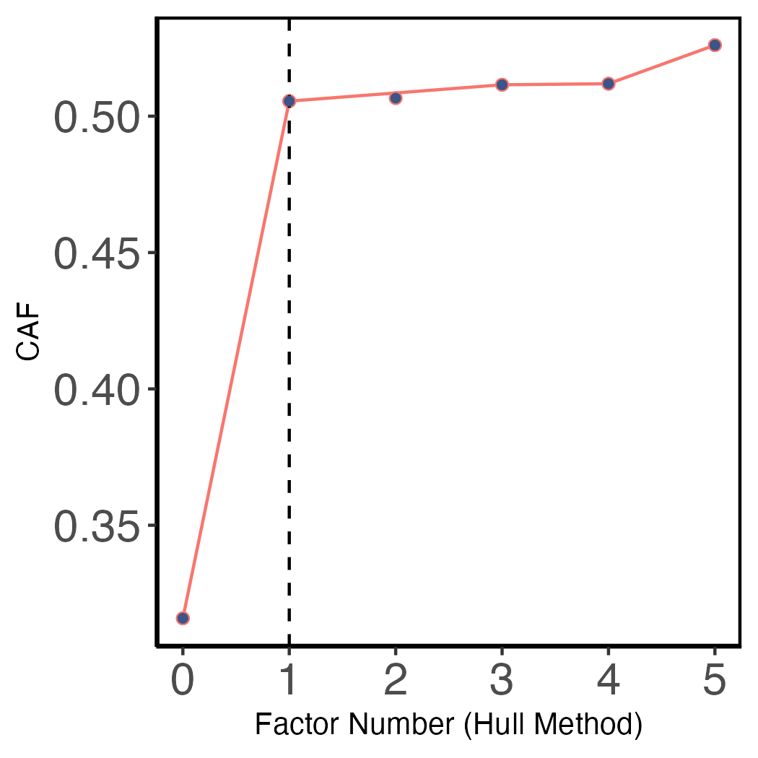
Exploratory factor analysis
LoC | Rotter’s I-E | Validation | Hands-on
Factor identification
Scree plot
Hull method
(Cattell, 1966; Lorenzo-Seva et al., 2011)

Slide 20



LoC
Relationship and luck
5 items
9.6% variance
Personal control vs luck
9 items
20.5% variance
Exploratory factor analysis
LoC | Rotter’s I-E | Validation | Hands-on
Two factor model
McDonald’s $_{t}$ =.39
McDonald’s $_{t}$ =.64
Personal Control vs Luck
11 items
32% Variance
One factor model
McDonald’s $_{t}$ =.70

Slide 21
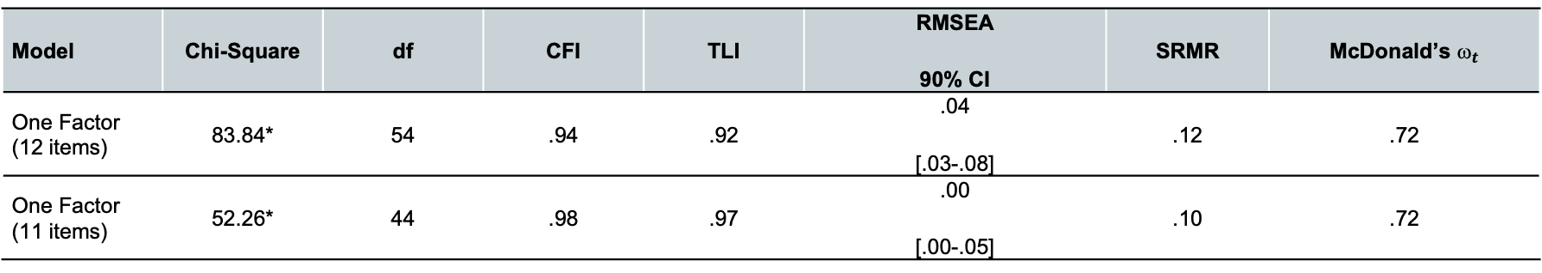
Validity
LoC | Rotter’s I-E | Validation | Hands-on
Structural validity
𝜒² | Non-significant
Comparative fit index (CFI) Tucker Lewis index(TLI) | close to/ ≥.95
Root mean square error of approximation (RMSEA) | close to/ ≤.06
Standardized root mean square (SRMR) | Close to/≤.08
Categorical confirmatory factor analysis
Robust weighted least square (WLSMV) estimator
Model | Chi-Square | df | CFI | TLI | RMSEA 90% CI | SRMR | McDonald’s $_{t}$
One Factor (12 items) | 83.84* | 54 | .94 | .92 | .04 [.03-.08] | .12 | .72
One Factor (11 items) | 52.26* | 44 | .98 | .97 | .00 [.00-.05] | .10 | .72
*p < 0.05
(Bentler & Chou, 1987; Hu & Bentler, 1999)

Slide 22



Validity
LoC | Rotter’s I-E | Validation | Hands-on
Convergent validity
Internal Control Index: The ICI is a 28-items 5-point scale to measure a person’s LoC
 | Rotter’s I-E Scale | Neuroticism | Openness
Neuroticism | .21* | -
Openness | -.22* | -.25** | -
Internal Control Index | -.22* | -.42** | .46**
Big Five Personality Inventory: We measured neuroticism and openness to experience by two subscales of the Big Five Inventory I
* p < 0.01 **p <.001
(Duttweiler, 1984; John et al., 1991; John et al., 2008)

Slide 23
Increasing the precision
LoC | Rotter’s I-E | Validation | Hands-on
How IRT is different than classical test theory?
IRT is a probabilistic model where:
Response on item ~ Level of the underlying trait θ
The probability of endorsing an item is a function θ, item difficulty, item discrimination and guessing
Estimated θ by IRT is not dependent on the items used.
Item difficulty: Latent trait level required for answering an item correctly
Item discrimination: Power of an item to distinguish individuals with low and high latent trait levels
Guessing: The probability of answering an item correctly for the examinees whose latent trait levels are very low
Item information: Amount of information an item carries along the latent trait
Test information: Amount of information an item carries along the latent trait
(Baker, 2017)

Slide 24
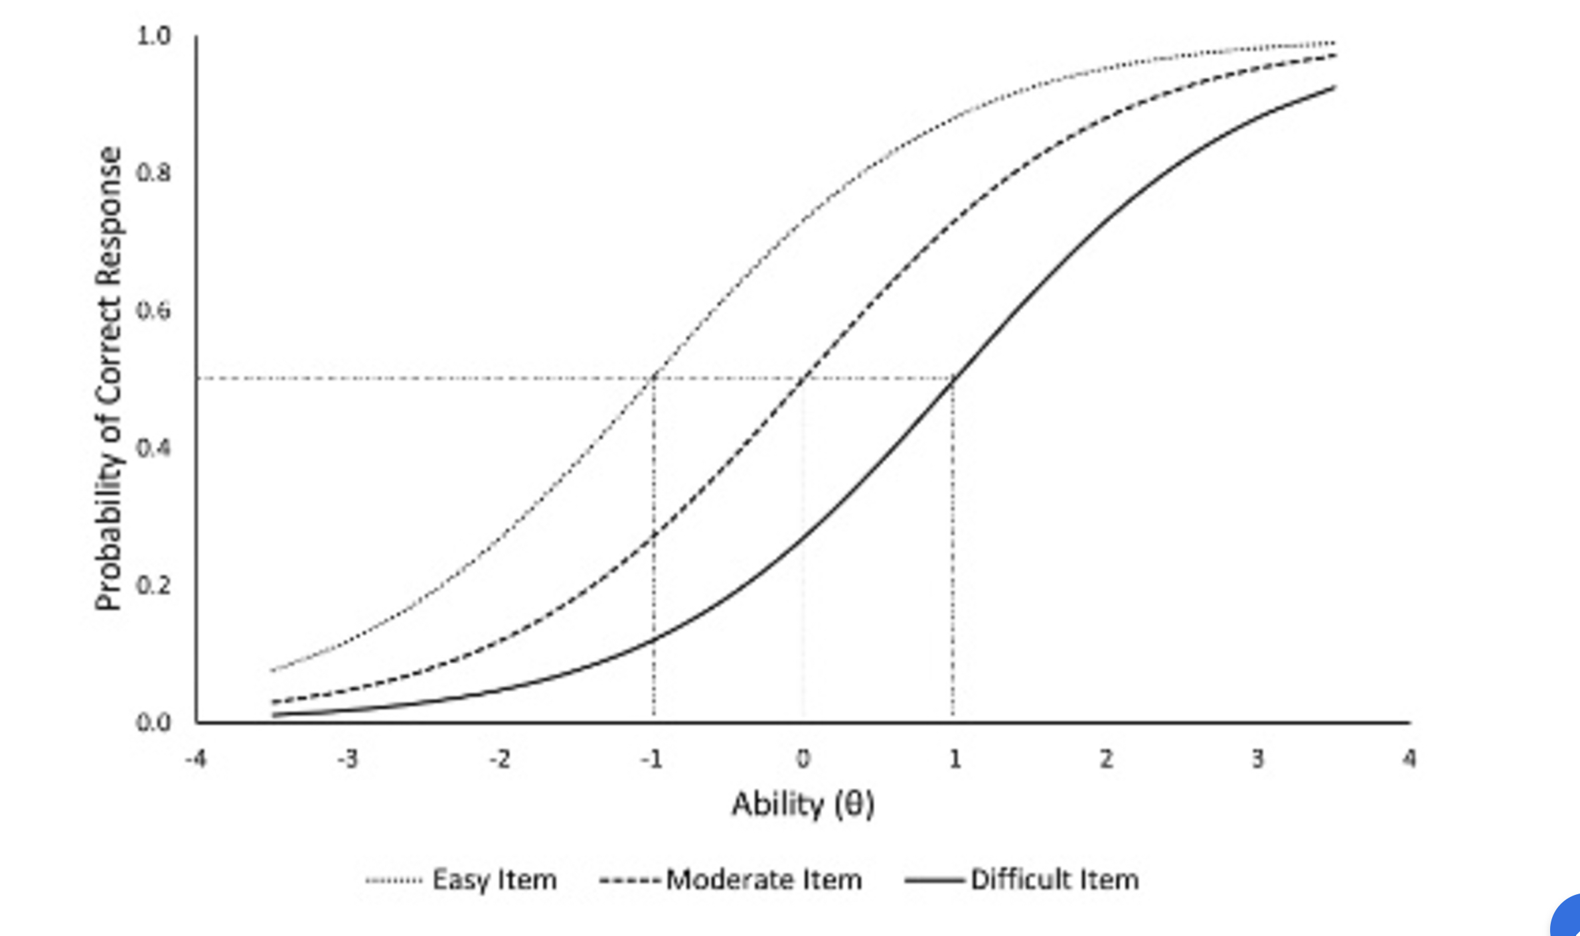
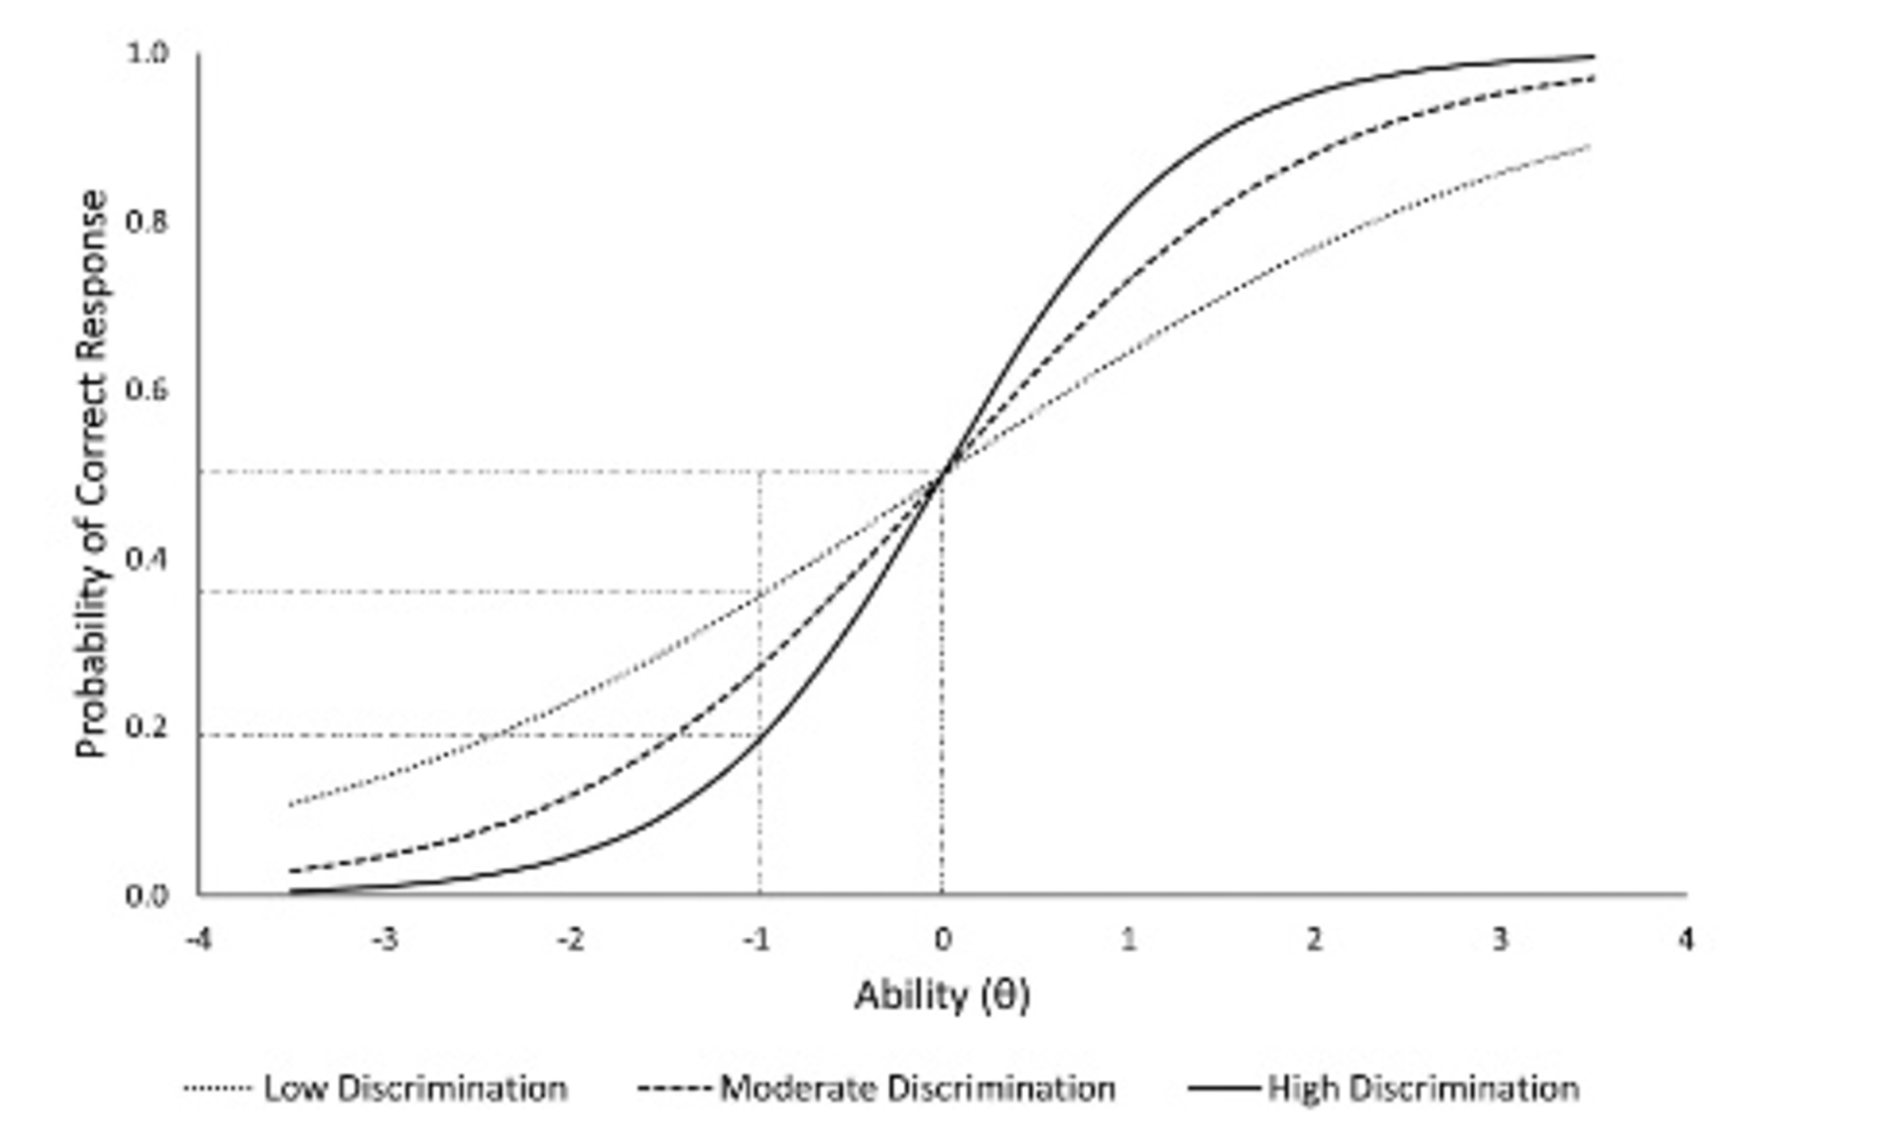
Item response theory
LoC | Rotter’s I-E | Validation | Hands-on
Same discrimination level
But differ in difficulty
Same difficulty level
But differ in discrimination
(Desjardins, 2018)

Slide 25
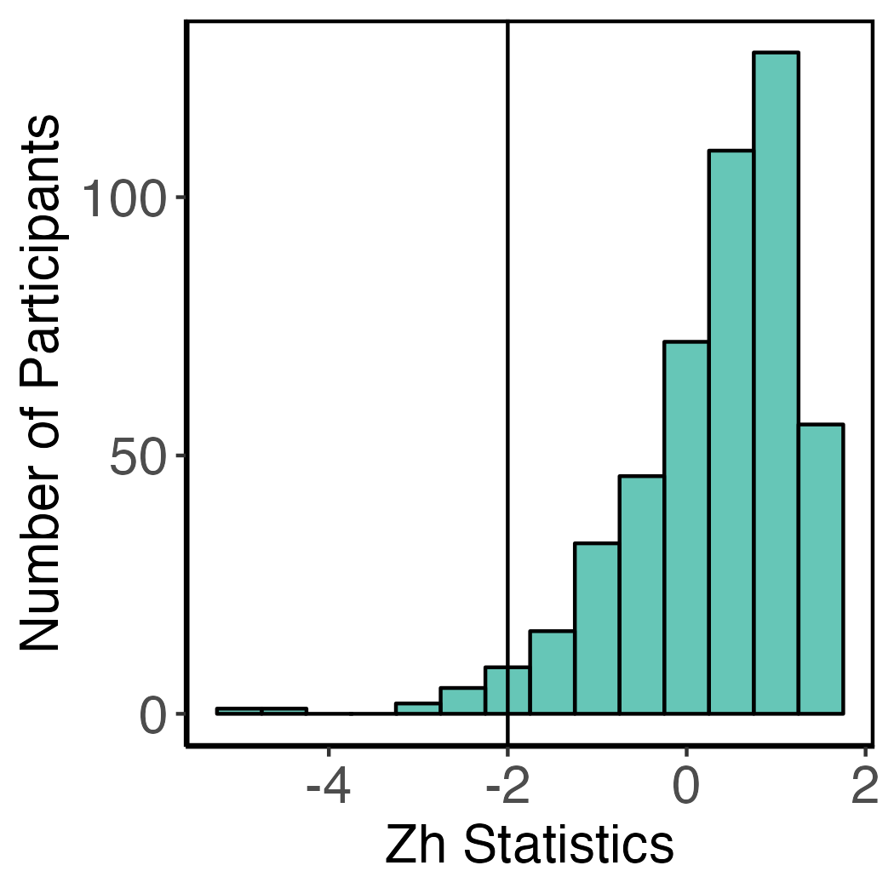
Model fitting
LoC | Rotter’s I-E | Validation | Hands-on
IRT model suitable for dichotomous items
One parameter logistic model: Discrimination power is considered equal for all items
Two parameters logistic model: Discrimination and difficulty level is different for each item.
Three parameters logistic model:
Extension of 2-PL model with an extra parameter: guessing
Person Fit
When we fit a model in IRT we should always check
Model fit: M2 = 59.42, df = 44, p= .06, RMSEA = .03, CFI = .98, TLI = .98.
Item fit: Signed chi-square test (S-χ2)
Person fit: Standardized fit index Zh statistics
(Desjardins, 2018)

Slide 26
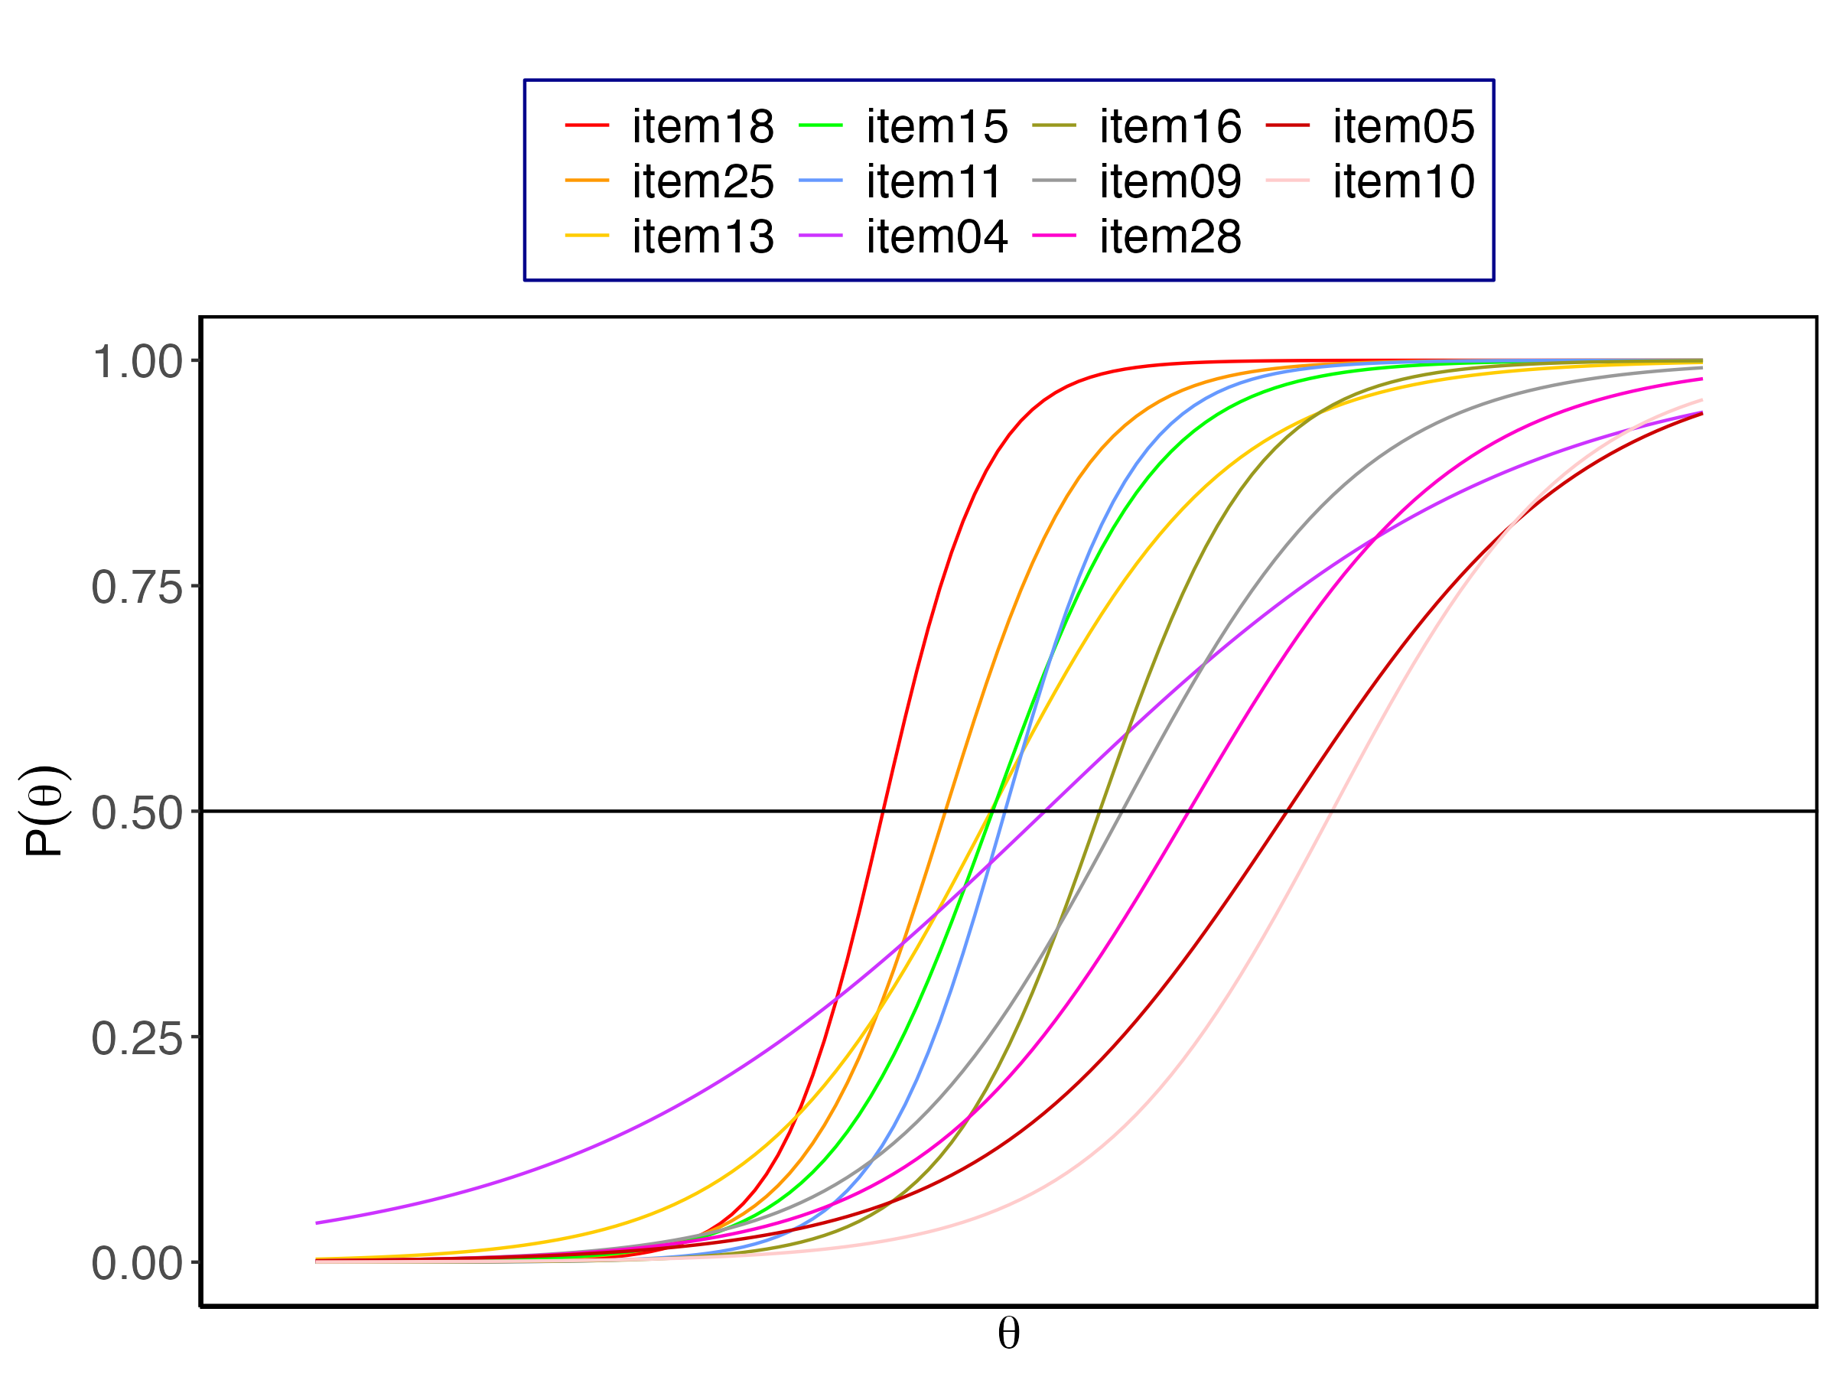
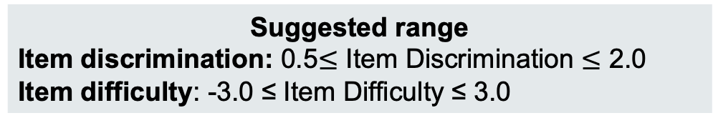
Item quality
LoC | Rotter’s I-E | Validation | Hands-on
Suggested range
Item discrimination: 0.5$≤$ Item Discrimination $≤$ 2.0
Item difficulty: -3.0 ≤ Item Difficulty ≤ 3.0
Item discrimination ranged between 0.49 to 2.21
Item 04 had very low discrimination
Items 05, 09, 10, 13, 28 had moderate discrimination
Items 15, 16 & 25 had high discrimination
Item 11 & 18 had very high discrimination.
(Baker, 2017; Desjardins, 2018)

Slide 27
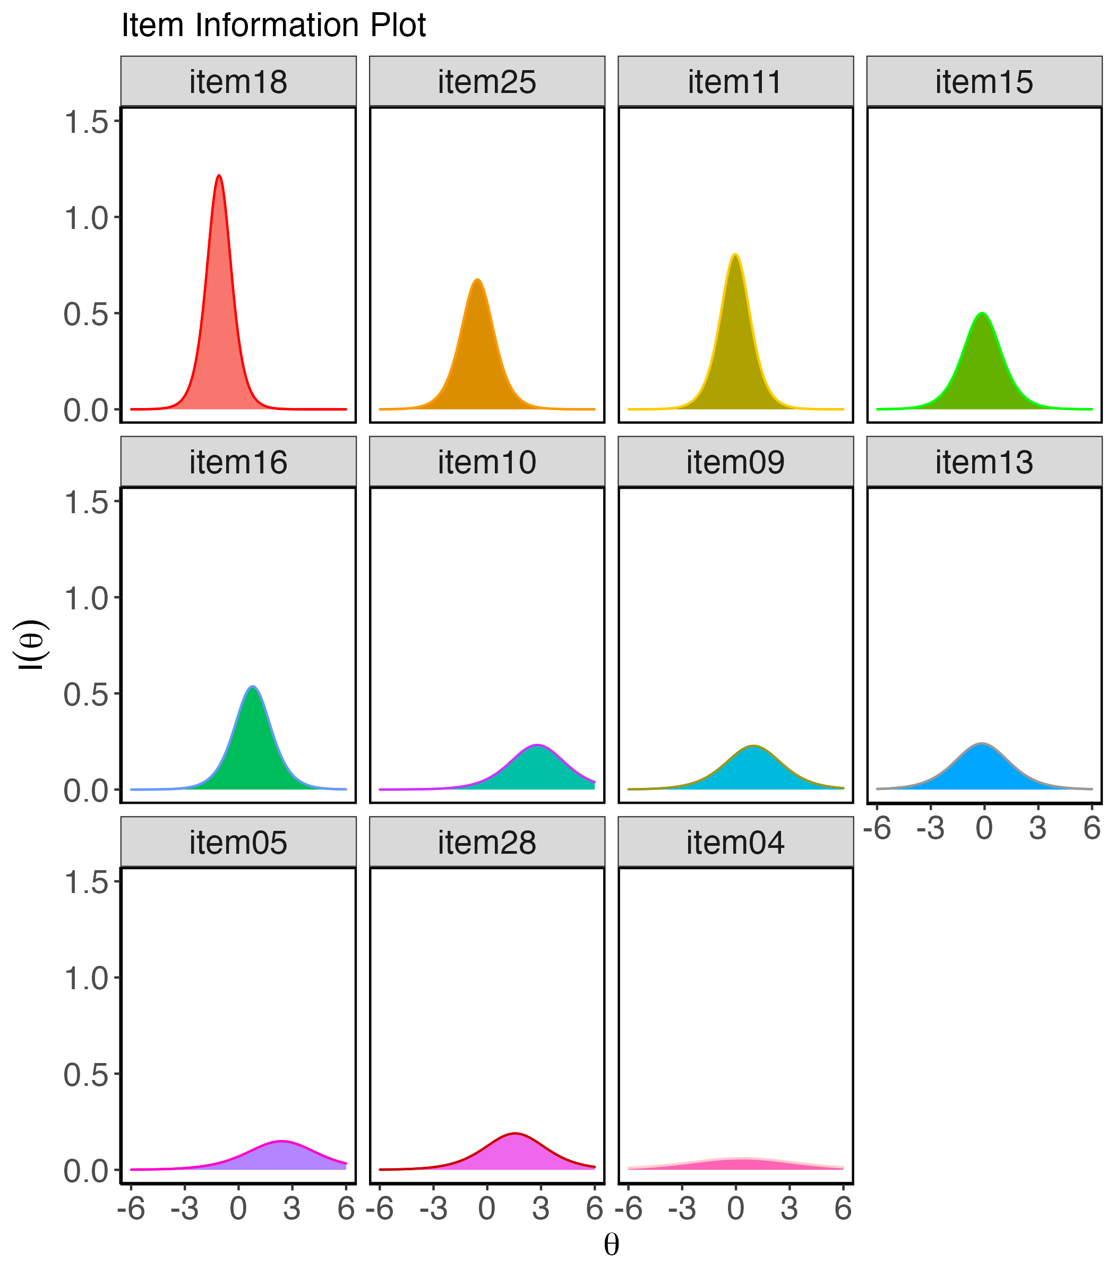
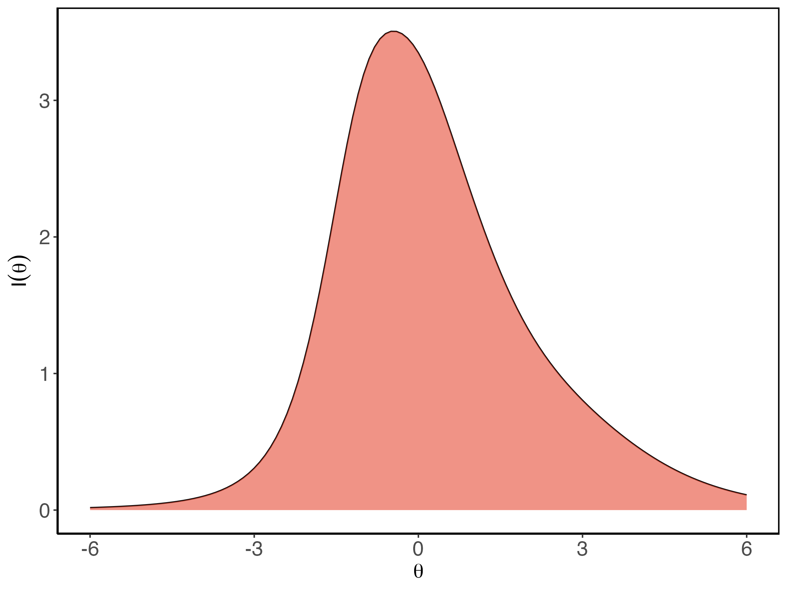
Item quality
LoC | Rotter’s I-E | Validation | Hands-on

Slide 28
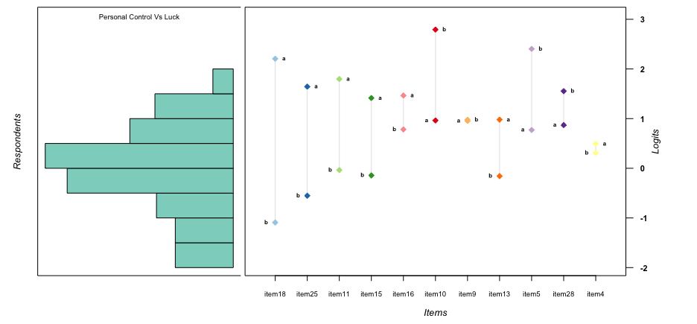
Item quality
LoC | Rotter’s I-E | Validation | Hands-on

Slide 29
Group activity 2: let’s categorize
LoC | Rotter’s I-E | Validation | Hands-on
Categorize the items according to their discrimination
Time: 5 mins
Items | Discrimination
Item 18 | 2.21
Item 25 | 1.64
Item 11 | 1.80
Item 15 | 1.41
Item 16 | 1.47
Item 10 | 0.96
Item 09 | 0.95
Item 13 | 0.98
Item 05 | 0.77
Item 28 | 0.87
Item 04 | 0.49
Item Discrimination Categorization Guideline
None = 0;
Very low =0.01 to 0.34;
Low = 0.35 to 0.64;
Moderate = 0.65 to 1.34;
High = 1.35 to 1.69;
Very high >1.70

Slide 30

It’s Break Time!
Before you take a break please participate in my survey

Slide 31
Hands-on
LoC | Rotter’s I-E | Validation | Hands-on
Let’s do some R
Sample Size Estimation
Descriptives
Exploratory Factor Analysis
Confirmatory Factor Analysis
IRT

Slide 32


Hands-on
LoC | Rotter’s I-E | Validation | Hands-on

Slide 33










Hands-on
LoC | Rotter’s I-E | Validation | Hands-on
Raw data
R Environment
Output

Slide 34

Hands-on
LoC | Rotter’s I-E | Validation | Hands-on
Visit this link and download the practice file

Slide 35
References
Baker, F. B. (2017). The Basics of Item Response Theory Using R (S.-H. Kim, Ed. 1st 2017. ed.). Cham : Springer International Publishing : Imprint: Springer.
Bartram, D., Berberoglu, G., Grégoire, J., Hambleton, R., Muniz, J., & van de Vijver, F. (2018). ITC Guidelines for Translating and Adapting Tests (Second Edition). International journal of testing, 18(2), 101-134. https://doi.org/10.1080/15305058.2017.1398166
Bentler, P. M., & Chou, C.-P. (1987). Practical Issues in Structural Modeling. Sociological methods & research, 16(1), 78-117. https://doi.org/10.1177/0049124187016001004
Cattell, R. B. (1966). The Scree Test For The Number Of Factors. Multivariate Behavioral Research, 1(2), 245-276. https://doi.org/10.1207/s15327906mbr0102_10
Child, D. (2006). Essentials of factor analysis (3 ed.). New York: Continuum.
Comrey, A. L., & Lee, H. B. (1992). A first course in factor analysis, 2nd ed. Lawrence Erlbaum Associates Inc.
Desjardins, C. D. (2018). Handbook of educational measurement and psychometrics using R (O. Bulut & ProQuest, Eds.). Boca Raton, FL : CRC Press.
Duttweiler, P. C. (1984). The Internal Control Index: A Newly Developed Measure of Locus of Control. Educational and psychological measurement, 44(2), 209-221. https://doi.org/10.1177/0013164484442004
Fabrigar, L. R., Wegener, D. T., MacCallum, R. C., & Strahan, E. J. (1999). Evaluating the Use of Exploratory Factor Analysis in Psychological Research. Psychological methods, 4(3), 272-299. https://doi.org/10.1037/1082-989X.4.3.272
Hofstede, G. (1980). Culture's consequences : international differences in work-related values. Beverly Hills, Calif. : Sage Publications.
Hu, L. t., & Bentler, P. M. (1999). Cutoff criteria for fit indexes in covariance structure analysis: Conventional criteria versus new alternatives. Structural Equation Modeling: A Multidisciplinary Journal, 6(1), 1-55. https://doi.org/10.1080/10705519909540118
John, O. P., Donahue, E. M., & Kentle, R. L. (1991). The Big Five Inventory--Versions 4a and 5b.
John, O. P., Naumann, L. P., & Soto, C. J. (2008). Paradigm shift to the integrative Big Five trait taxonomy: History, measurement, and conceptual issues. 114-158.
Lorenzo-Seva, U., Timmerman, M., & Kiers, H. (2011). The Hull Method for Selecting the Number of Common Factors. Multivariate Behavioral Research, 46, 340-364. https://doi.org/10.1080/00273171.2011.564527
Marsh, H. W., & Richards, G. E. (1987). The Multidimensionality of the Rotter I-E Scale and its Higher-order Structure: An Application of Confirmatory Factor Analysis. Multivariate Behav Res, 22(1), 39-69. https://doi.org/10.1207/s15327906mbr2201_3
Mulaik, S. A. (2009). Foundations of Factor Analysis (Vol. 7). London: Chapman and Hall/CRC. https://doi.org/10.1201/b15851
Polit, D. F., Beck, C. T., & Owen, S. V. (2007). Is the CVI an acceptable indicator of content validity? Appraisal and recommendations. Res. Nurs. Health, 30(4), 459-467. https://doi.org/10.1002/nur.20199
Rotter, J. B. (1966). Generalized expectancies for internal versus external control of reinforcement. Psychol Monogr, 80(1), 1-28. https://doi.org/10.1037/h0092976
Smith, P. B., Trompenaars, F., & Dugan, S. (1995). The Rotter Locus of Control Scale in 43 Countries: A Test of Cultural Relativity. International Journal of Psychology, 30(3), 377-400. https://doi.org/10.1080/00207599508246576
Watkins, M. (2020). A Step-by-Step Guide to Exploratory Factor Analysis with R and RStudio. https://doi.org/10.4324/9781003120001

Slide 36


Thank you for your time!
For any further queries please contact:
Associate Prof. Shamsul Haque
Jeffrey Cheah School of Medicine &
Health Sciences
Monash University, Malaysia
shamsul@monash.edu
Mushfiqul Anwar Siraji
PhD Candidate
Jeffrey Cheah School of Medicine &
Health Sciences
Monash University, Malaysia
mushfiqul.anwarsiraji@monash.edu

